Slide 1
Video Analysis Demo
There is Video Analysis demonstration, I design and build Simple Data Platform from end to end and then answer for flowing question.
Author: Long Bui Van

Slide 2








Tech-stack Design
Compute Engine
Development Environment
Data Sources
Data Staging
Master
DWH
Worker
Worker
Worker
Local Storage

Slide 3
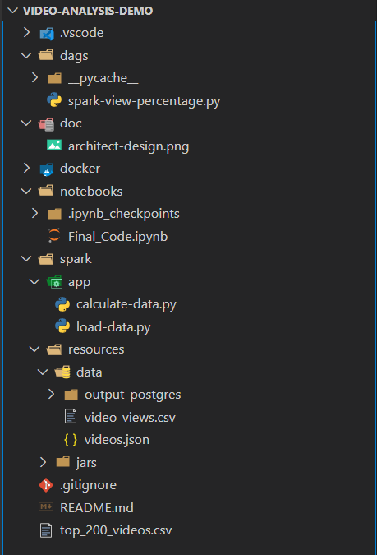
Components Design
Folder:
- dags: workflow management
- doc: documentation for project
- notebooks: development environment
- spark:
+ app: jobs for workflow
+ data: sample data for testing
- README.md: description for project
- docker: image building code which are not include in source code to minimize size of project

Slide 4
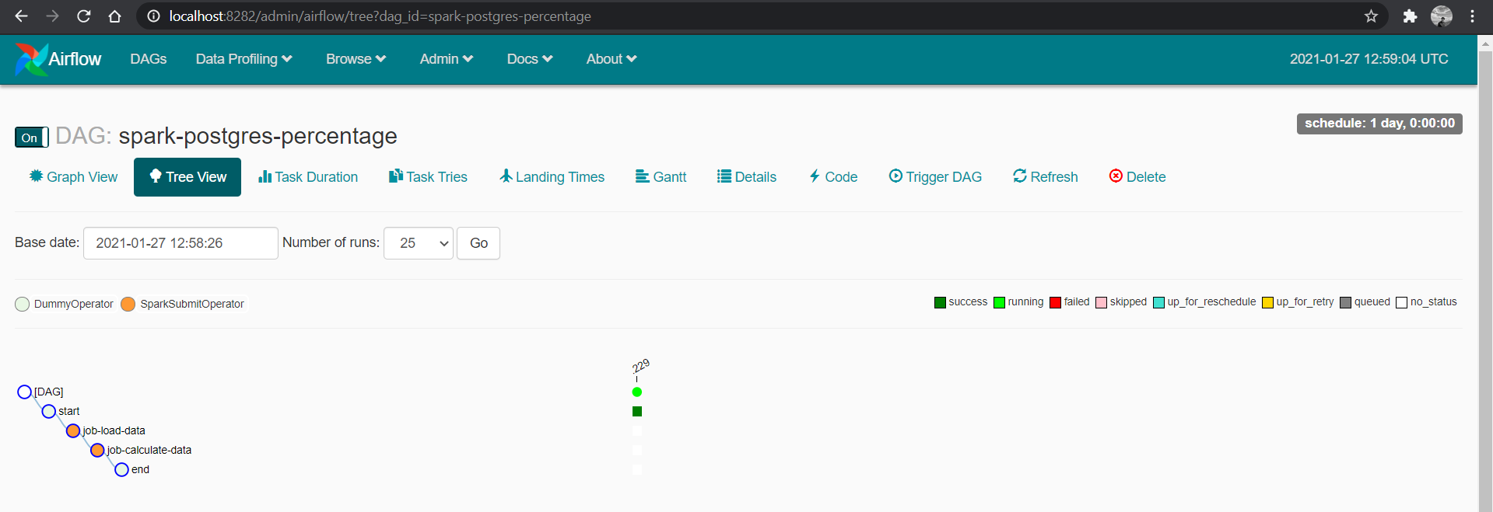
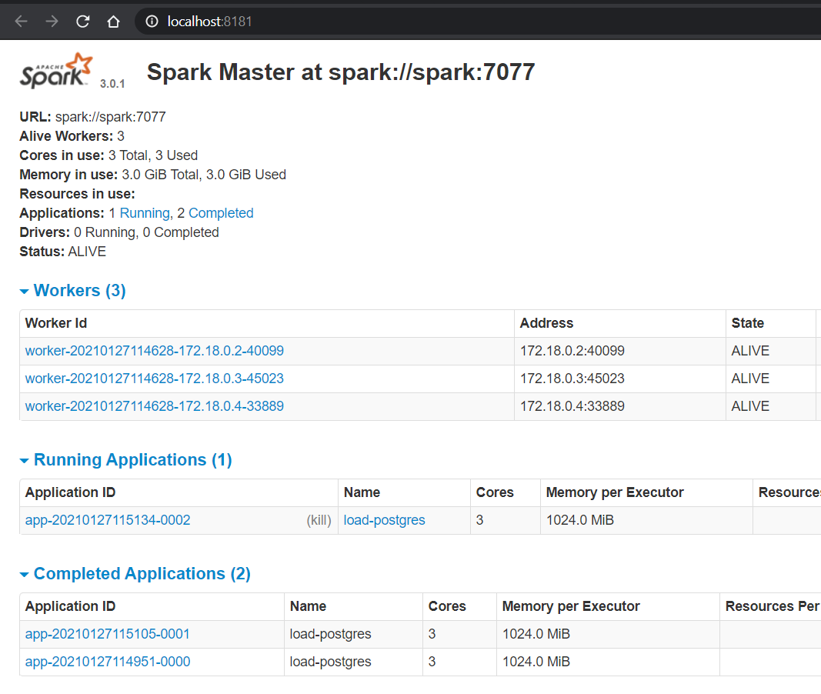
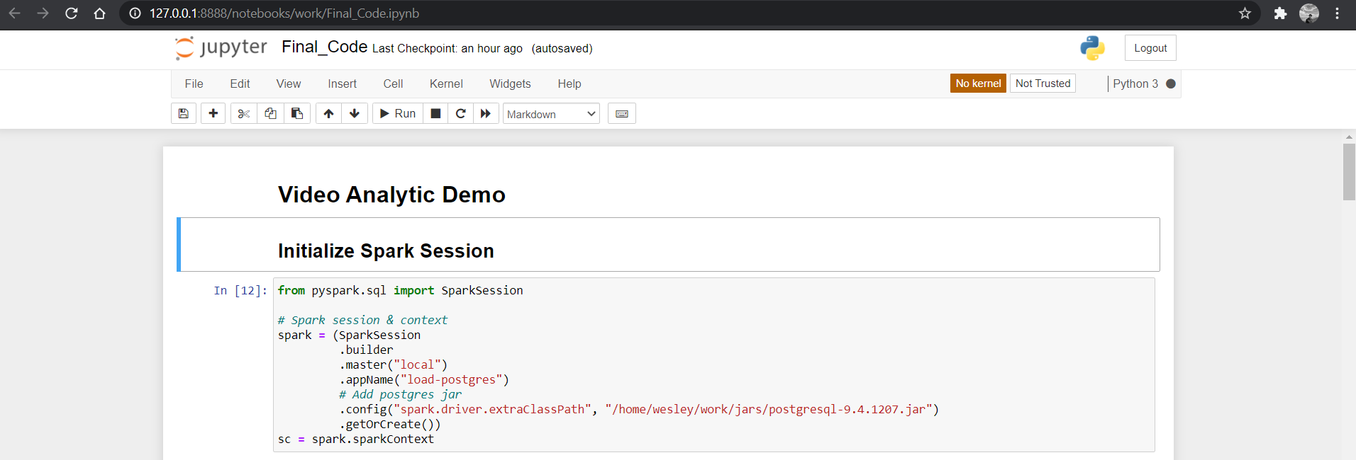
Result of Infrastructure
Spark-postgres-percentage DAG is deployed
Spark is running with 2 workers for load-postgres job
Jupyter is used for development environment

Slide 5

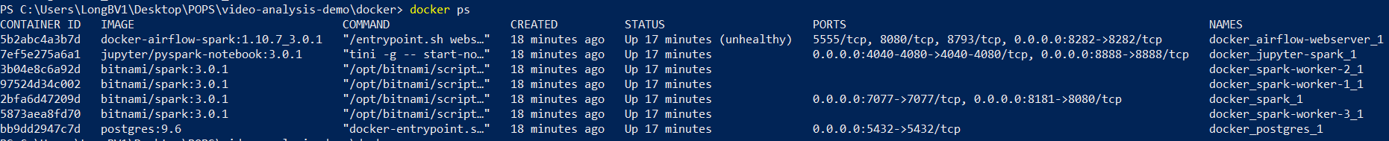
Project Setup
1. Build Airflow and Spark images
2. Run docker container by using “docker-compose.yml”
3. Config Spark Connection in Airflow

Slide 6
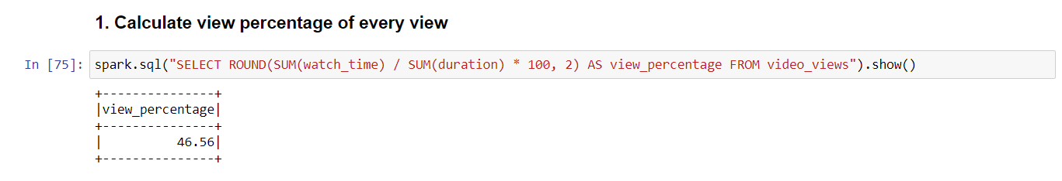
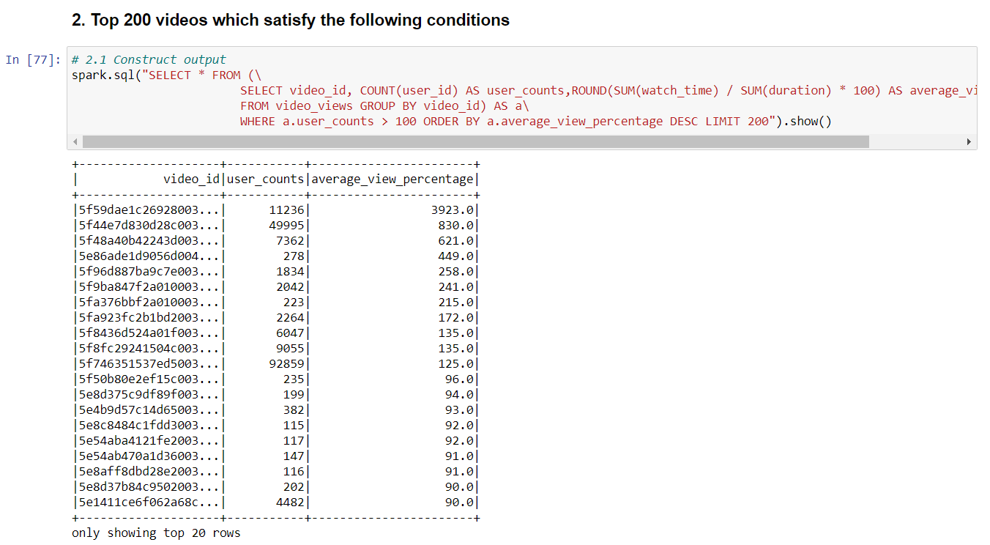
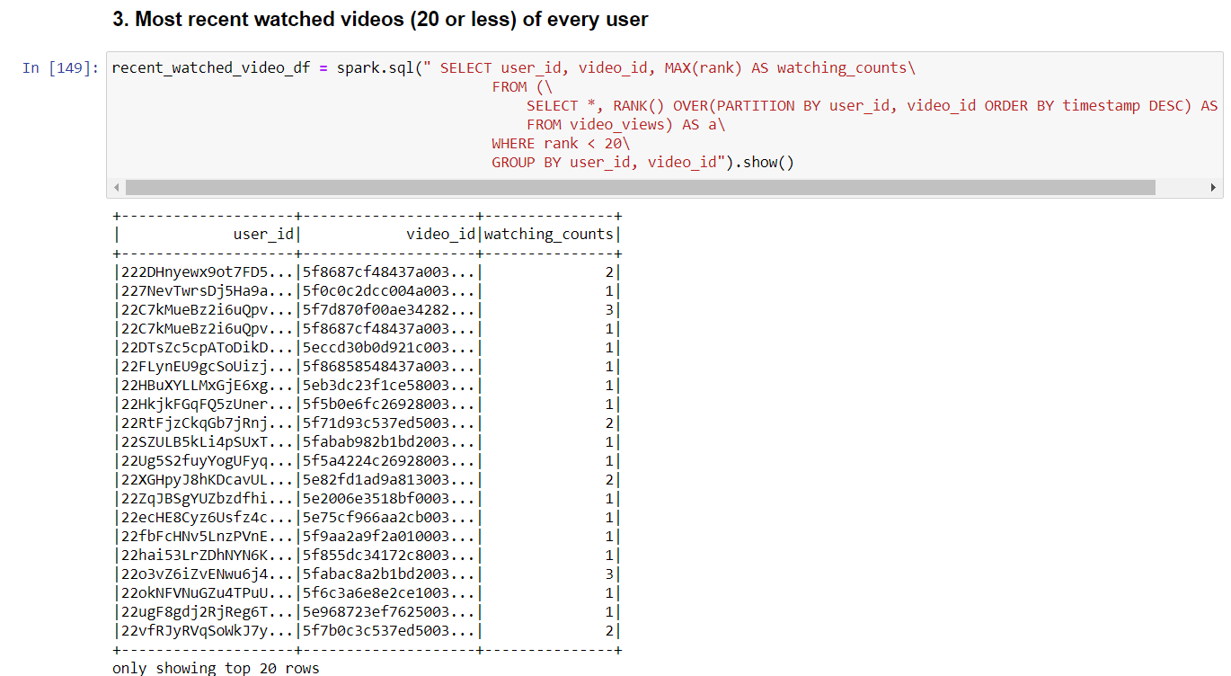
Result of Tasks
Top_200_videos.csv is attached in folder

Slide 7
Further Improvement
Integrate with Data Analysis Platform for further Analysis
Deploy on Cloud

